Slide 1
FOREX Prediction
Presented by:
Francis Ocran, IV

Slide 2
Motivation
I joined a FOREX group and was promised education and profits.
I received neither and ultimately lost money trying following strategies.
I stopped paying for education and started learning myself.
I made profit but lost my money by not being consistent.
This project will be used to construct an algo for better trades.

Slide 3
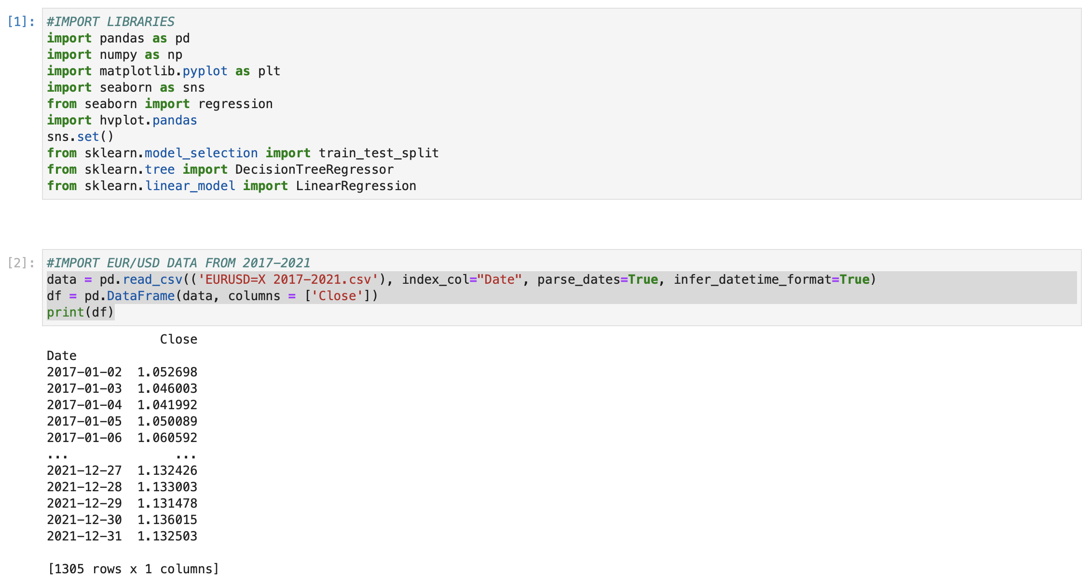

Slide 4
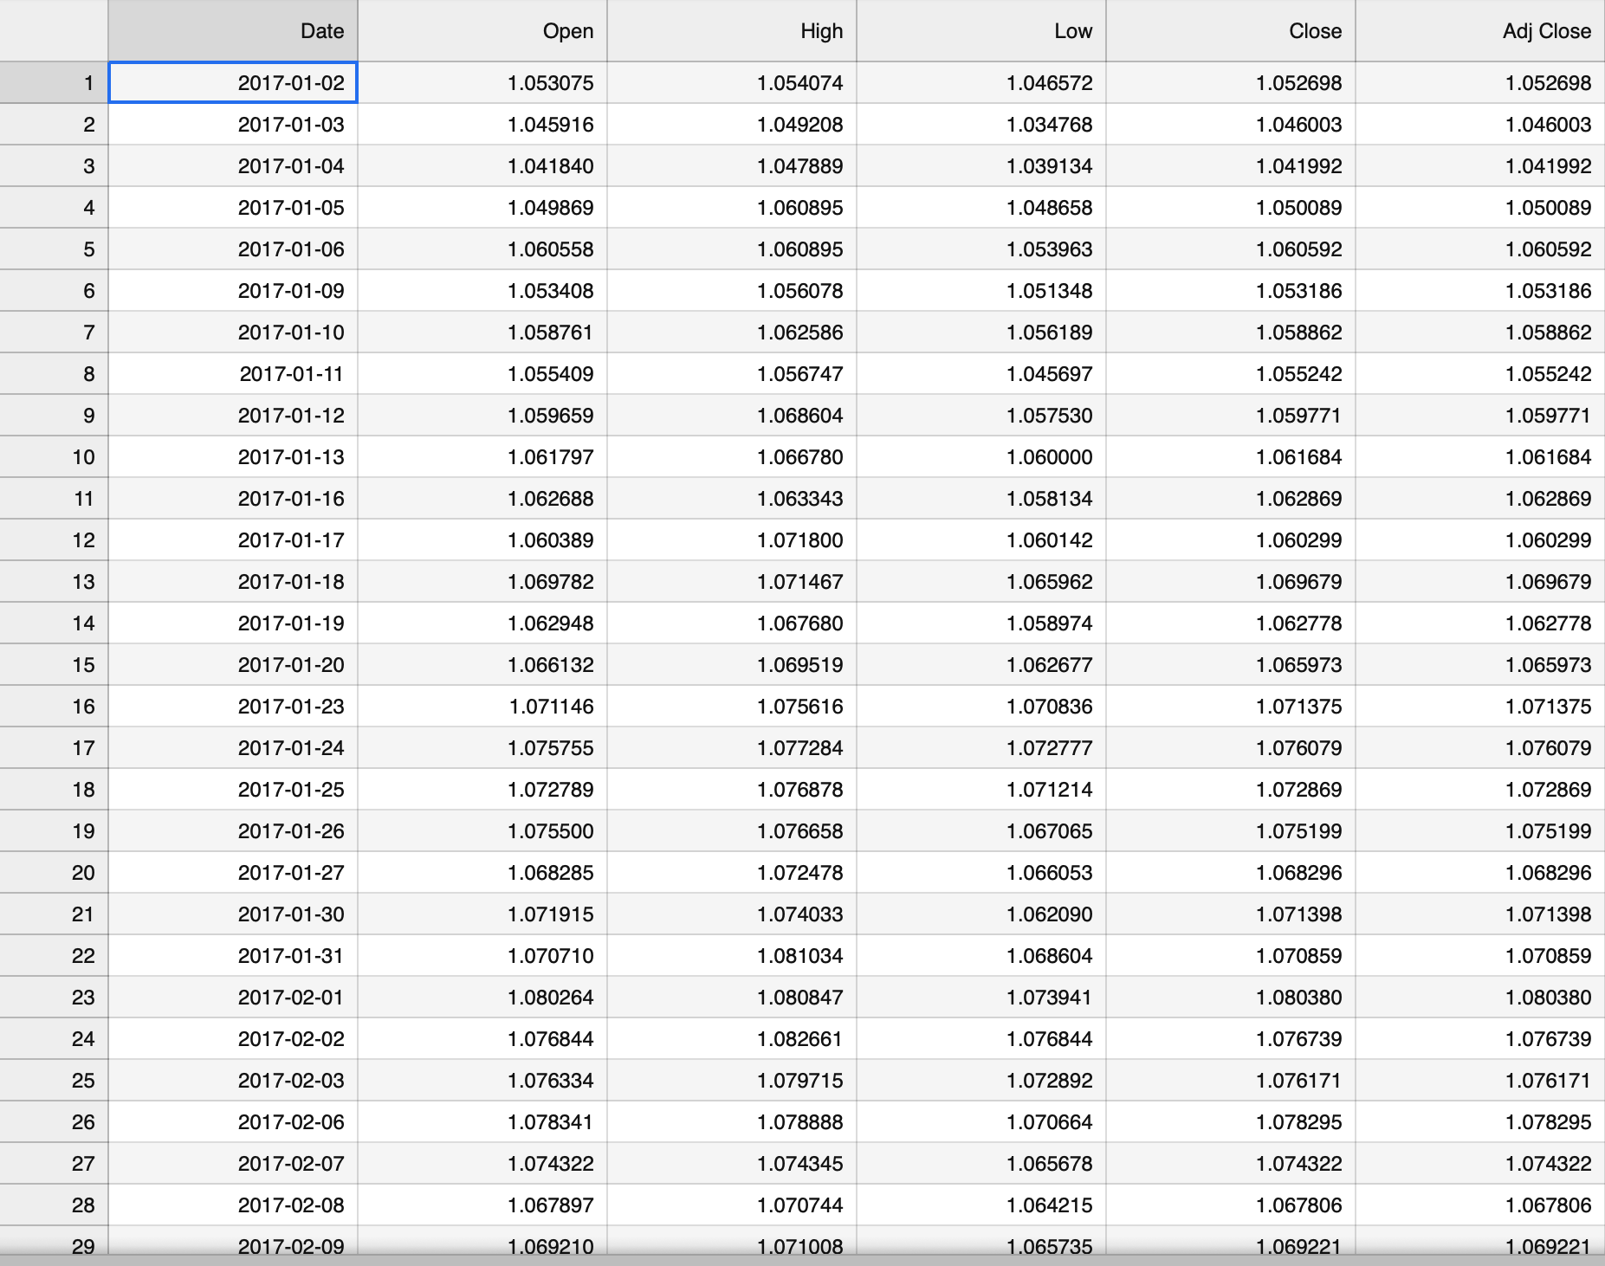

Slide 5
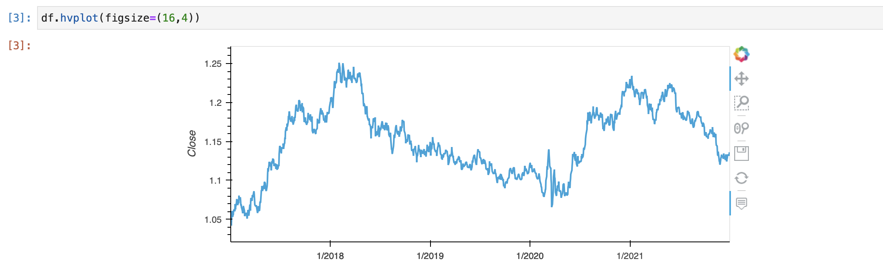

Slide 6
EUR/USD: Explanation
The Euro to Dollar exchange rate (EUR/USD or €/$ for short) is the amount in U.S. dollars that equals 1 Euro.
If EUR/USD increasing, the euro is getting stronger, or the U.S. dollar is getting weaker.

Slide 7
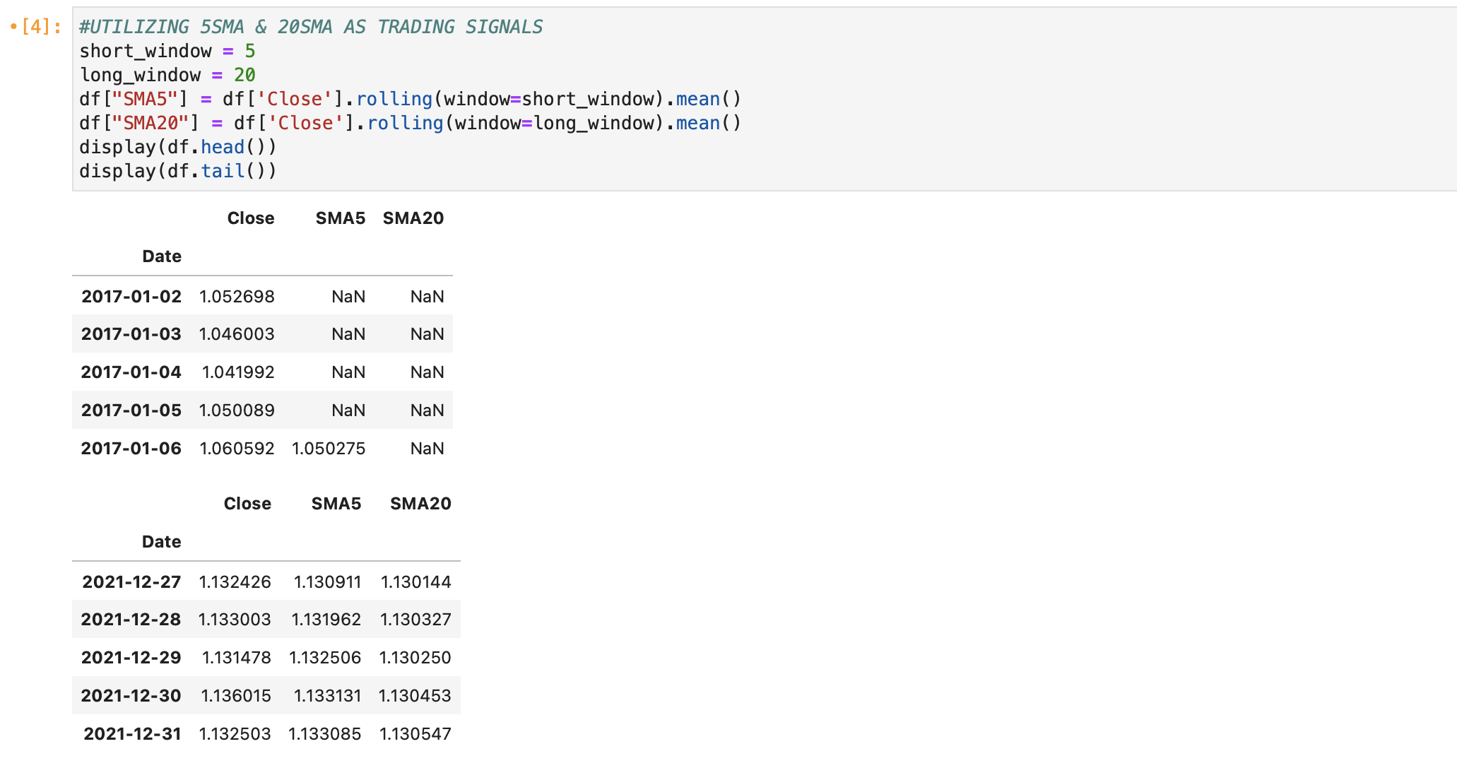

Slide 8
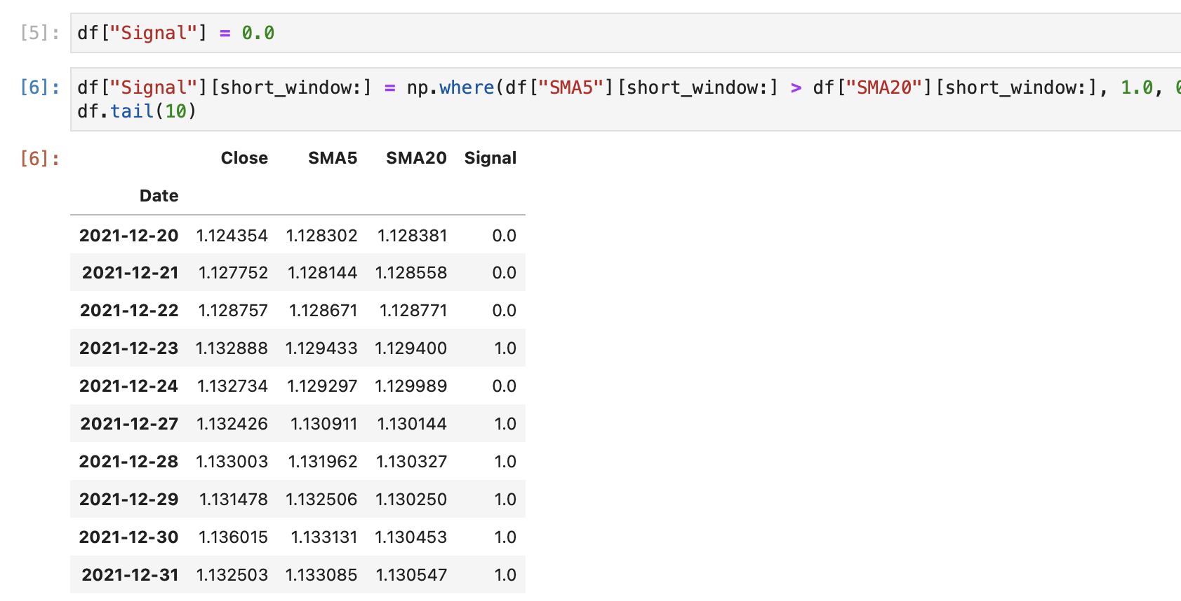

Slide 9
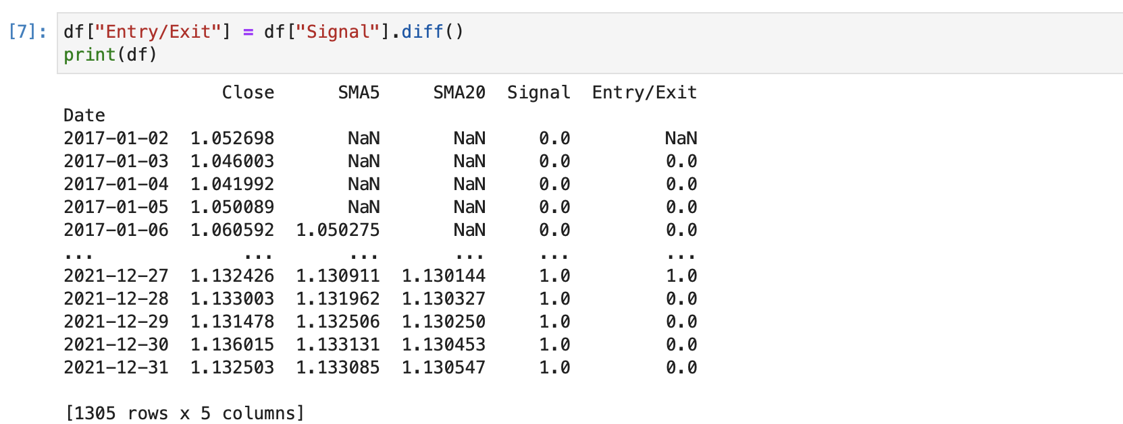

Slide 10
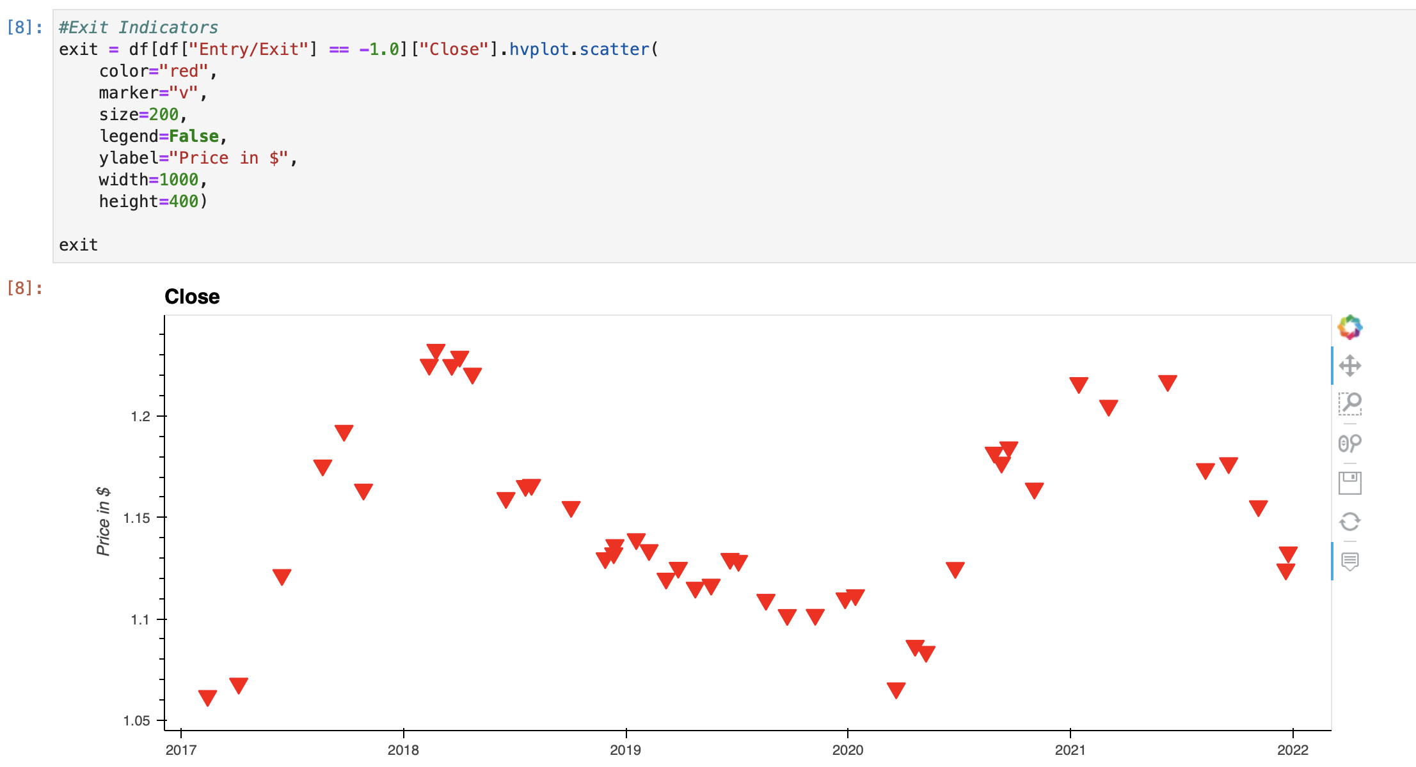

Slide 11
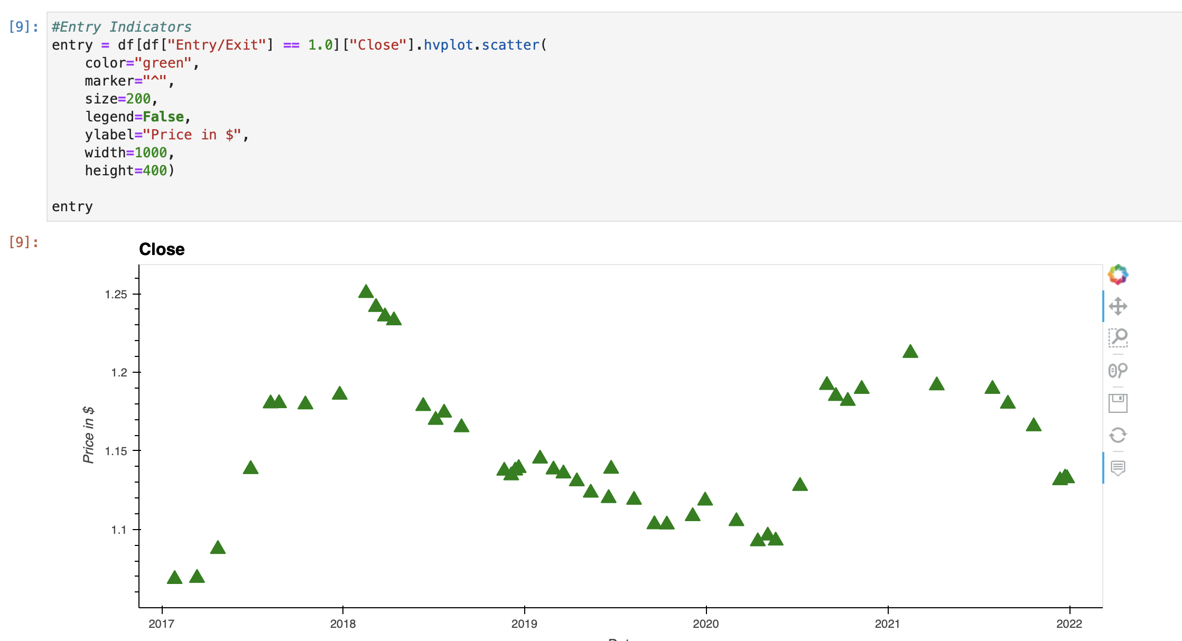

Slide 12
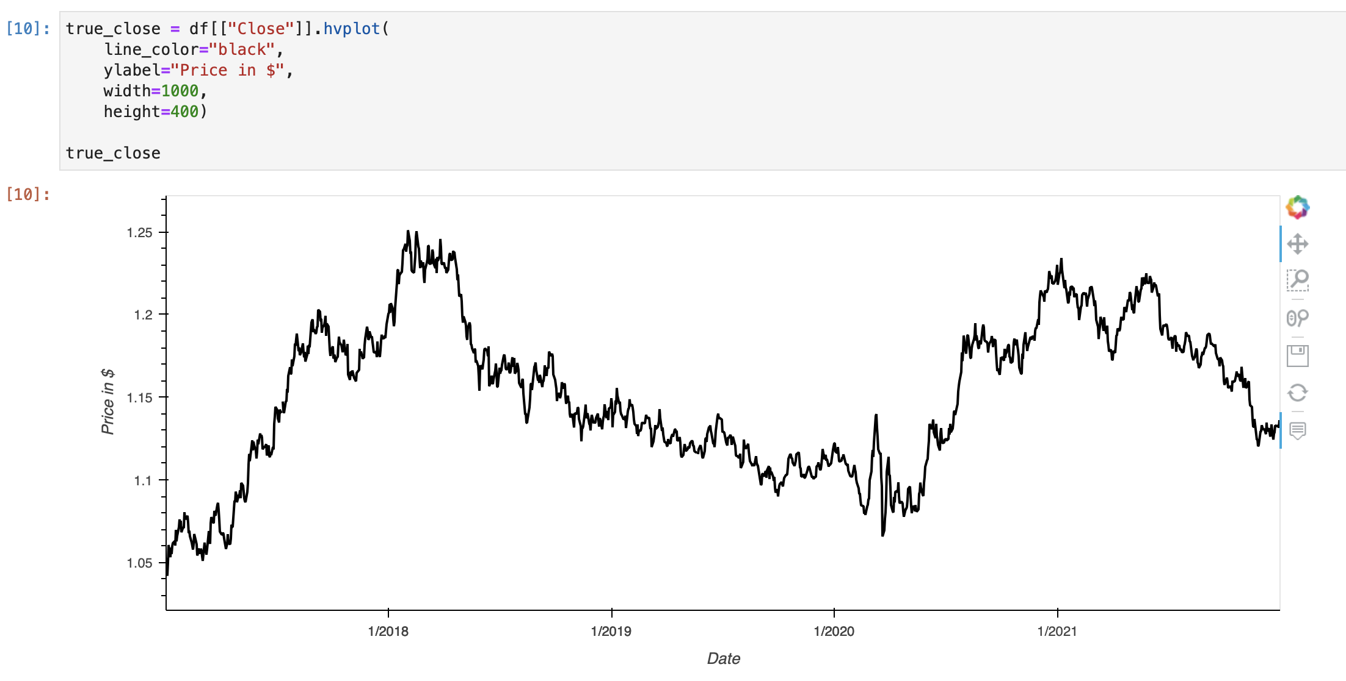

Slide 13
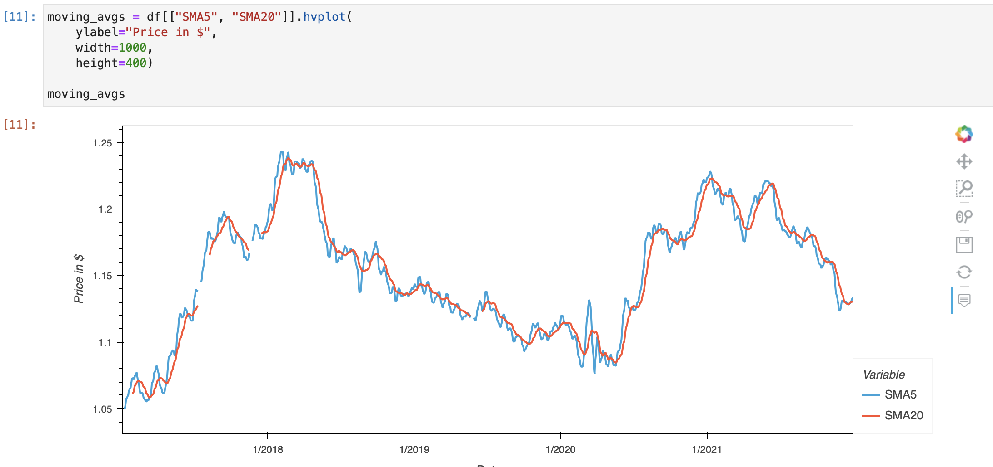

Slide 14
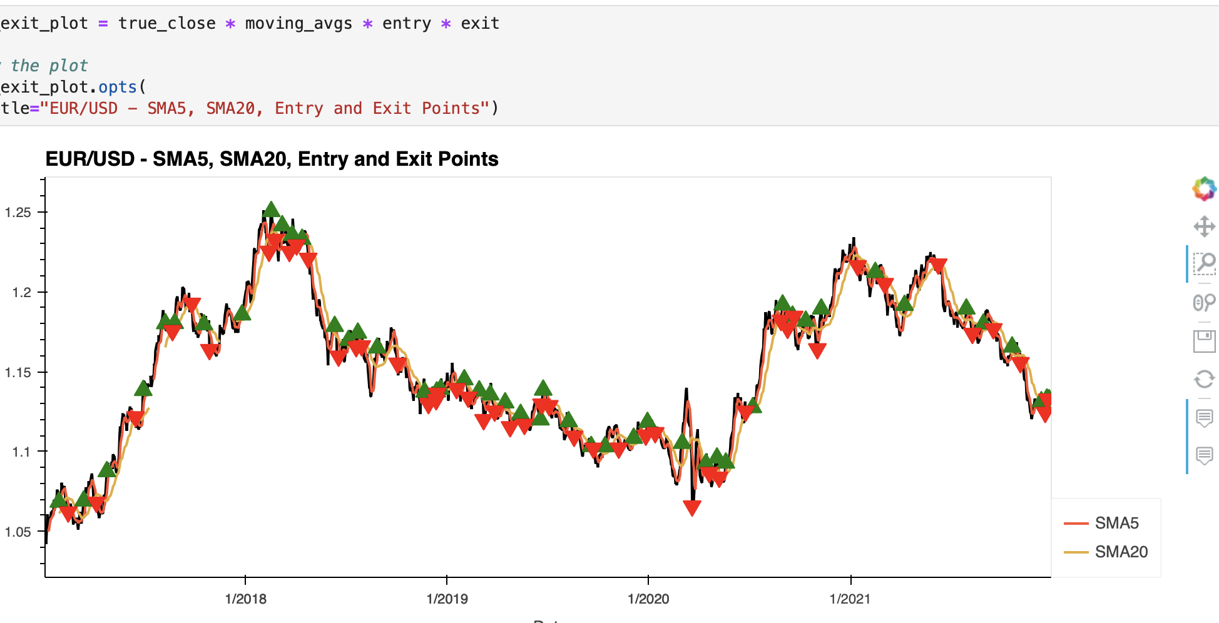

Slide 15
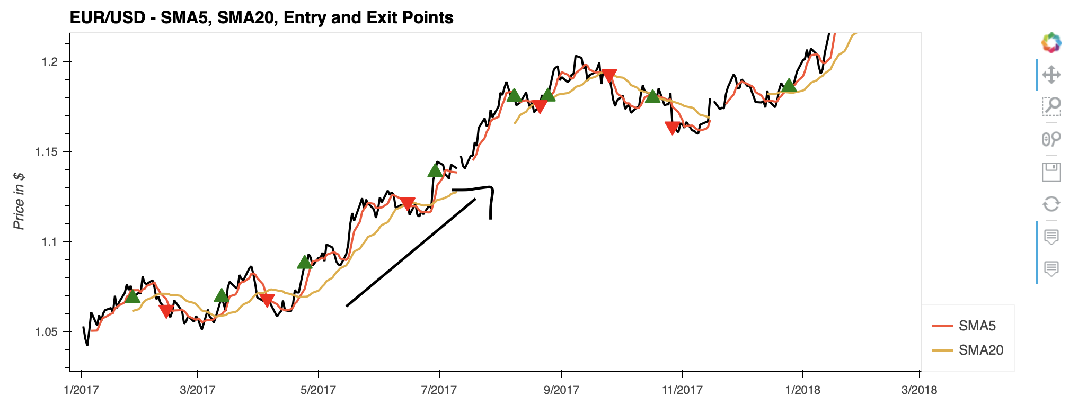

Slide 16
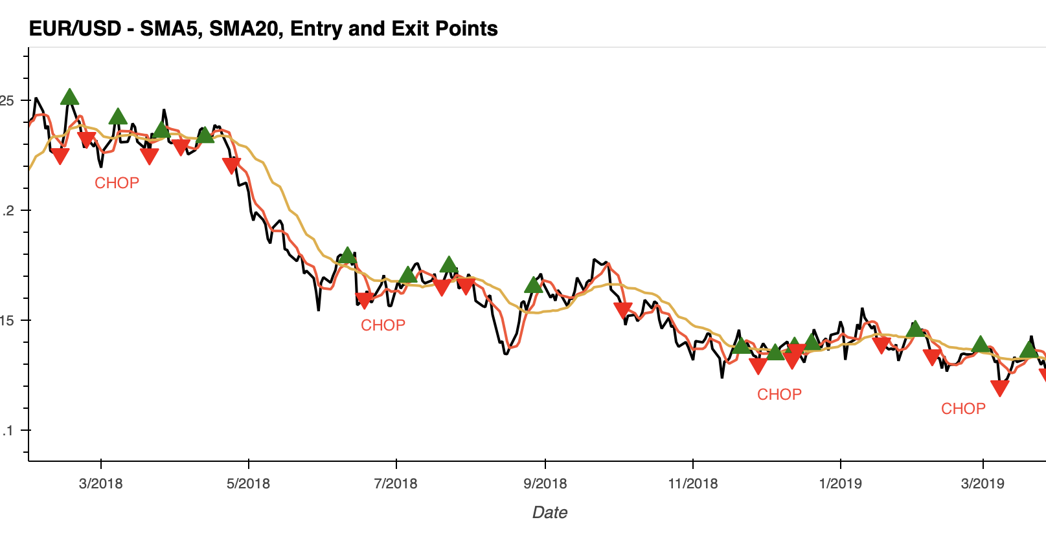

Slide 17
Consolidation = BAD
Solid Up/Down Trends = Fairly Accurate

Slide 18
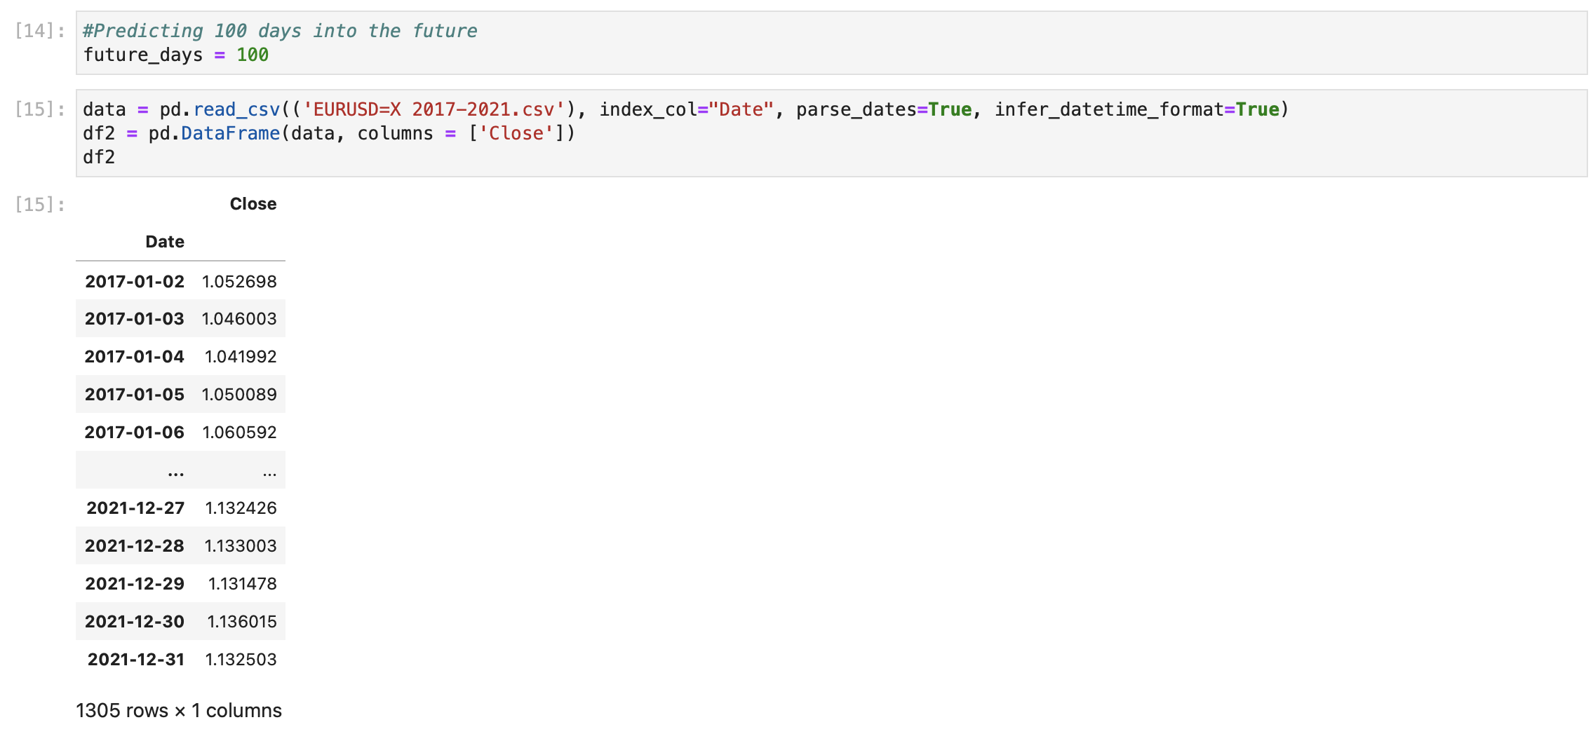

Slide 19
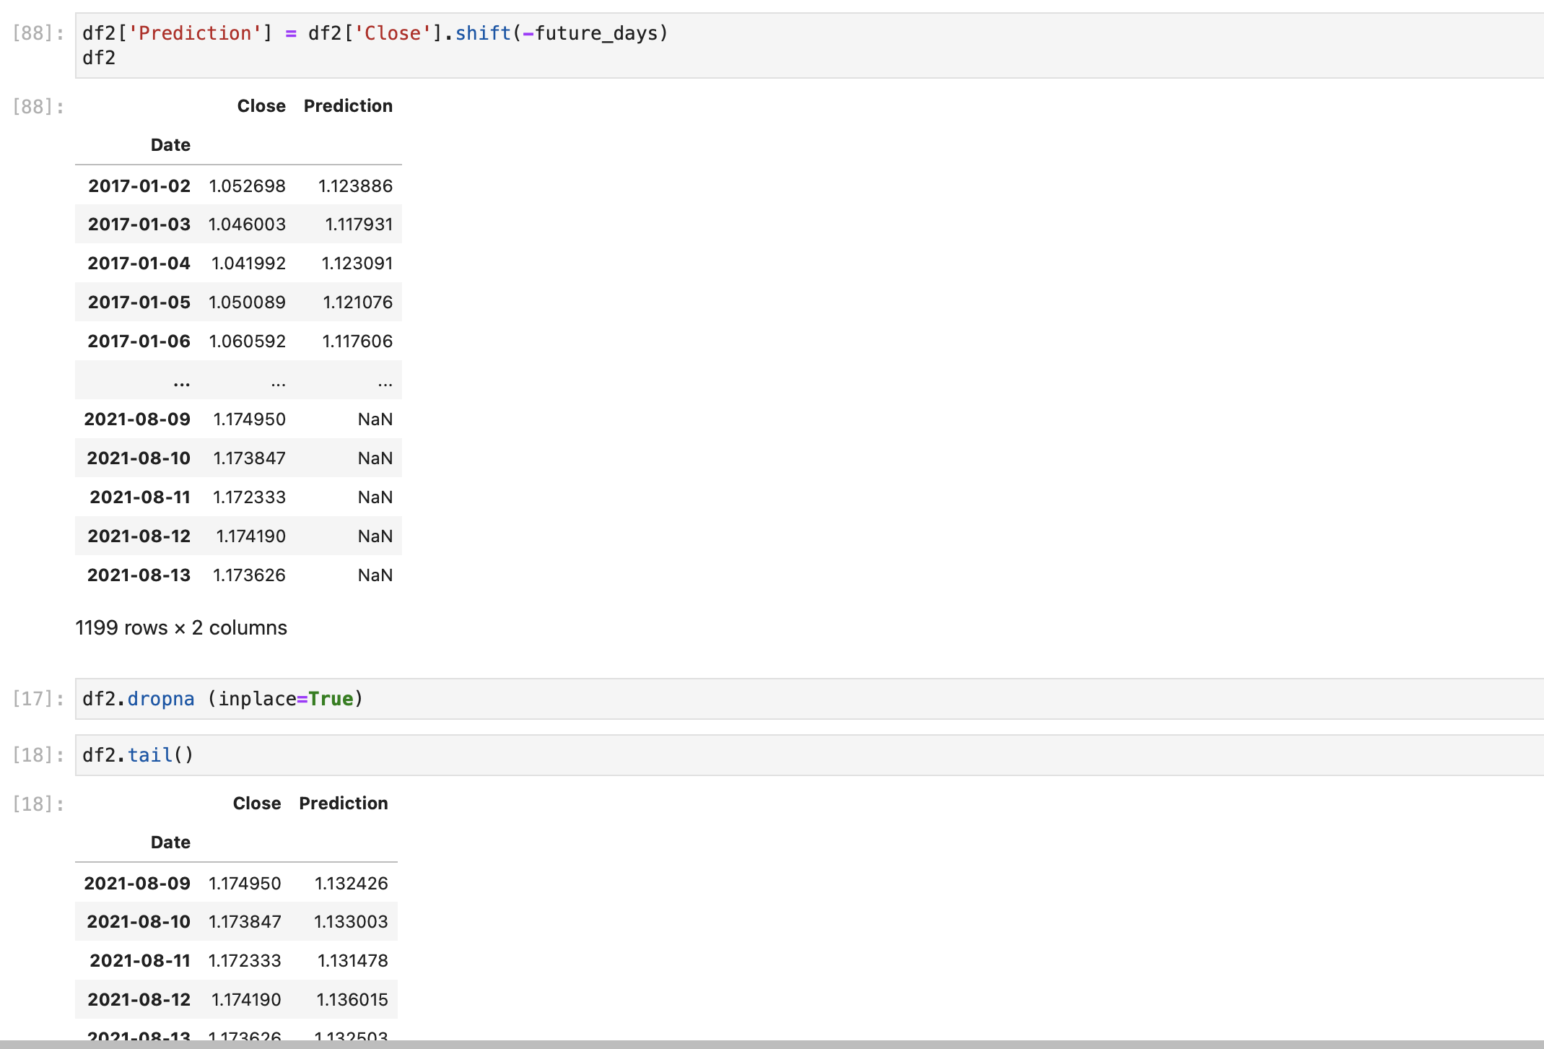

Slide 20
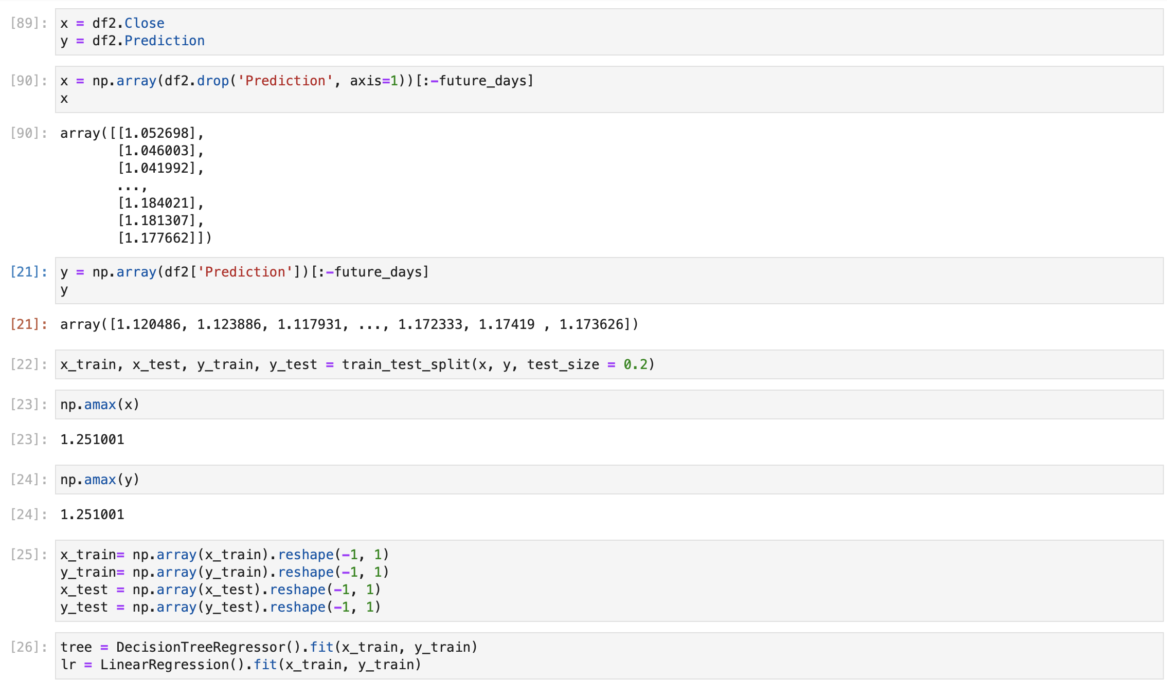

Slide 21
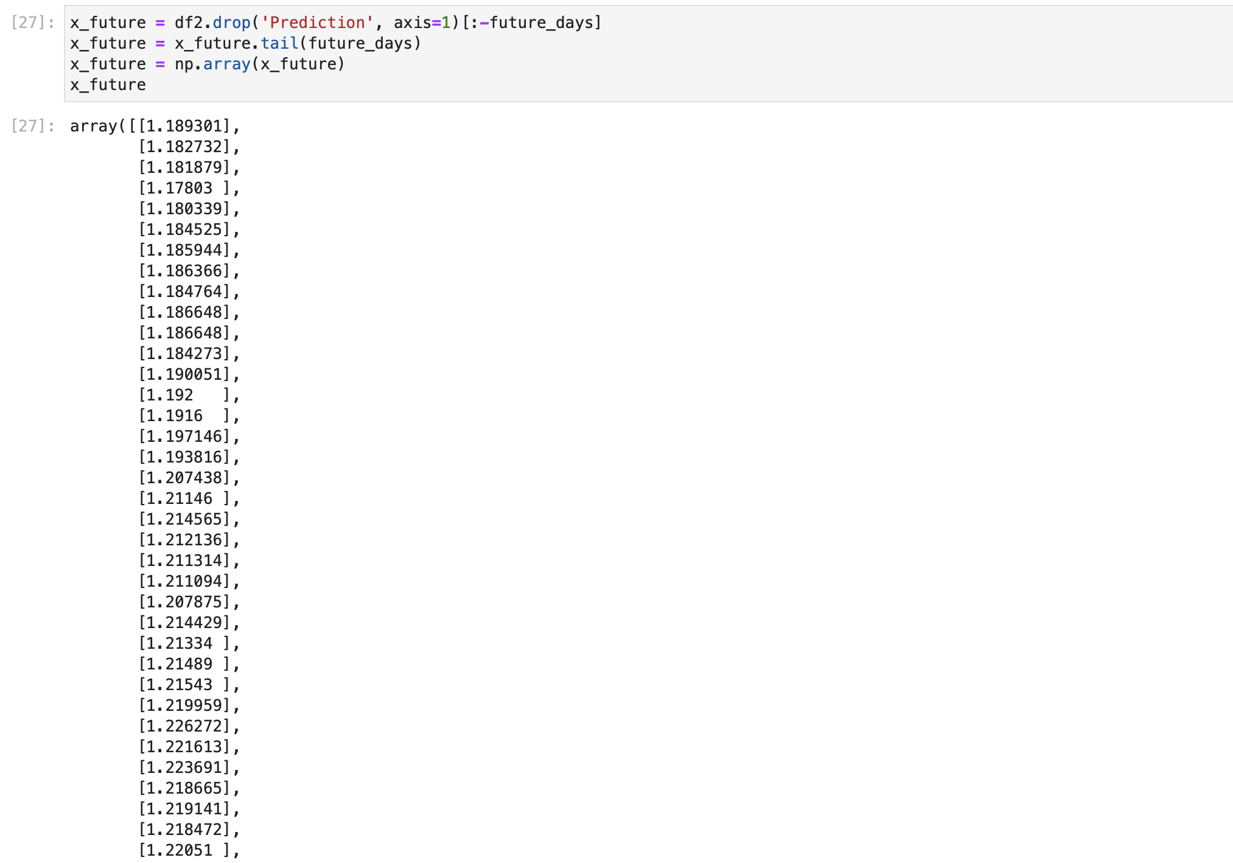

Slide 22
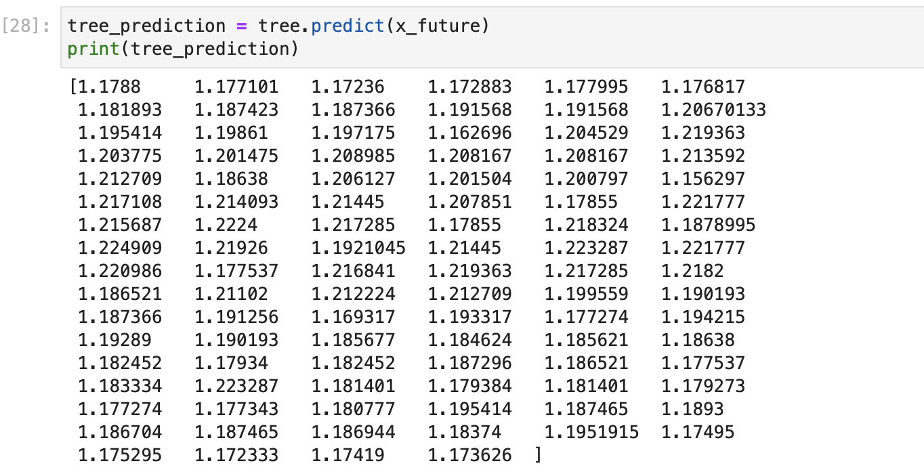

Slide 23
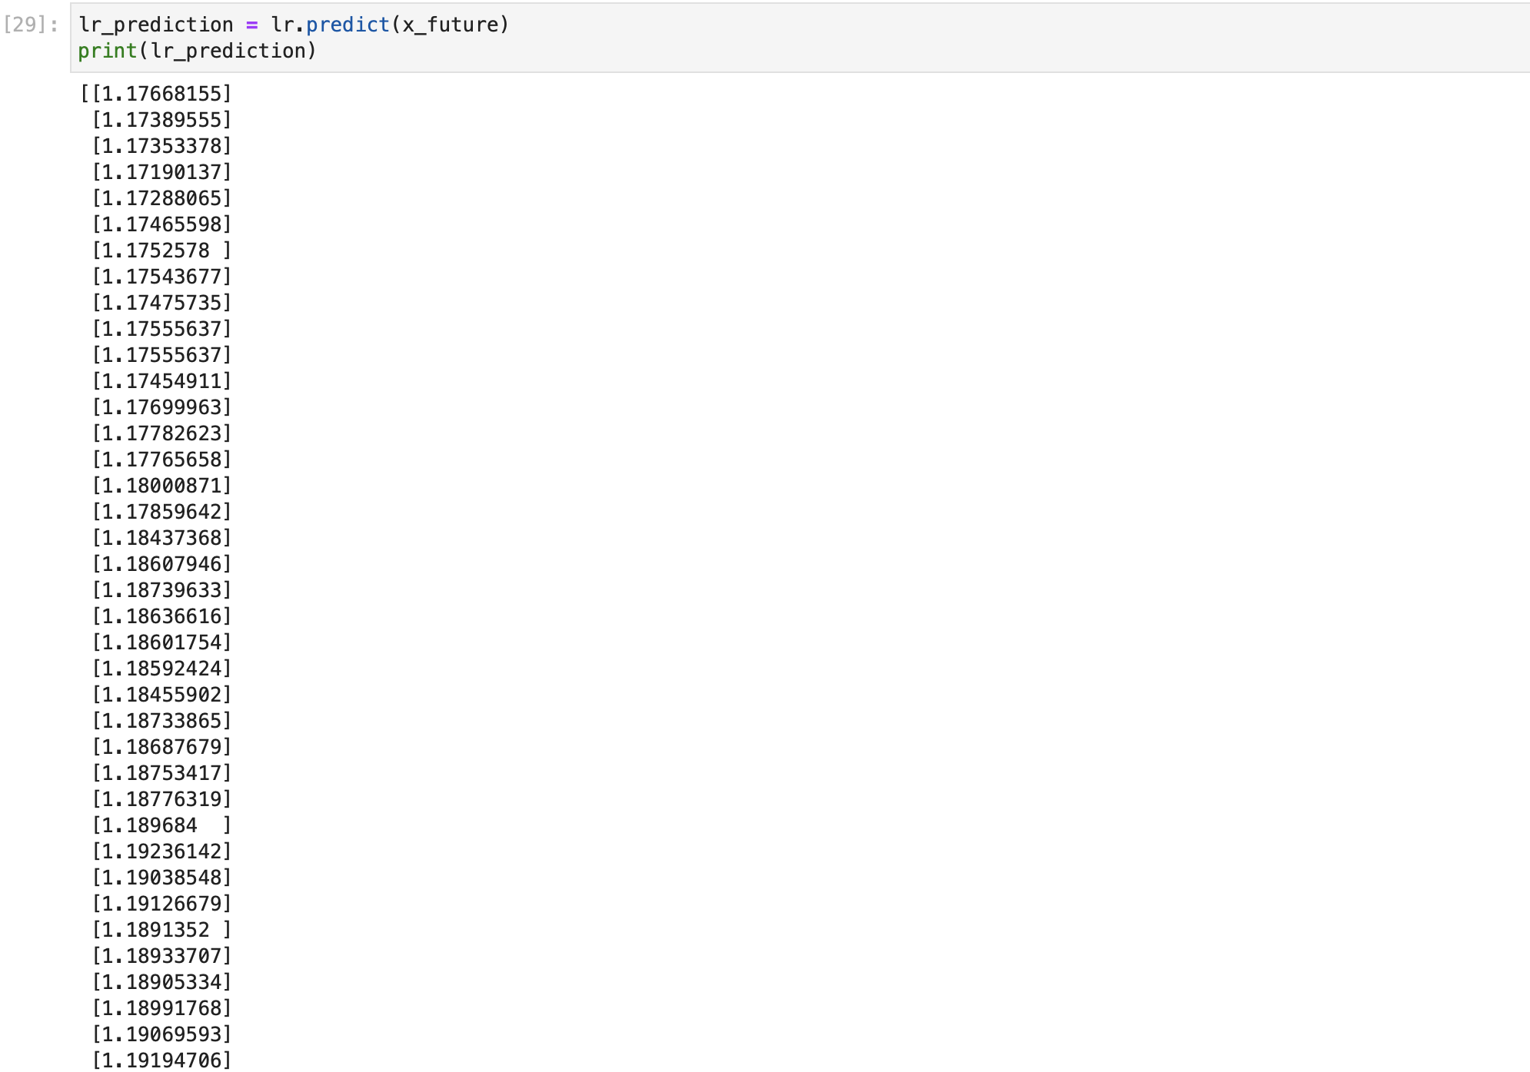

Slide 24
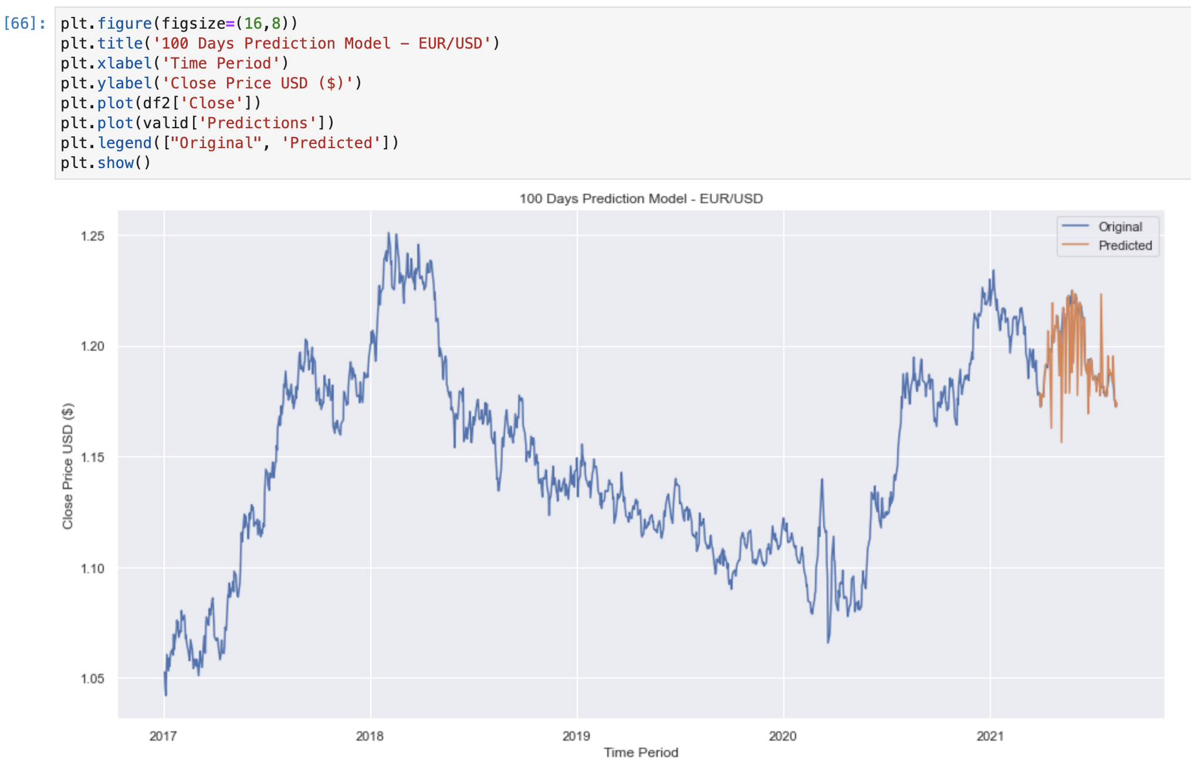

Slide 25
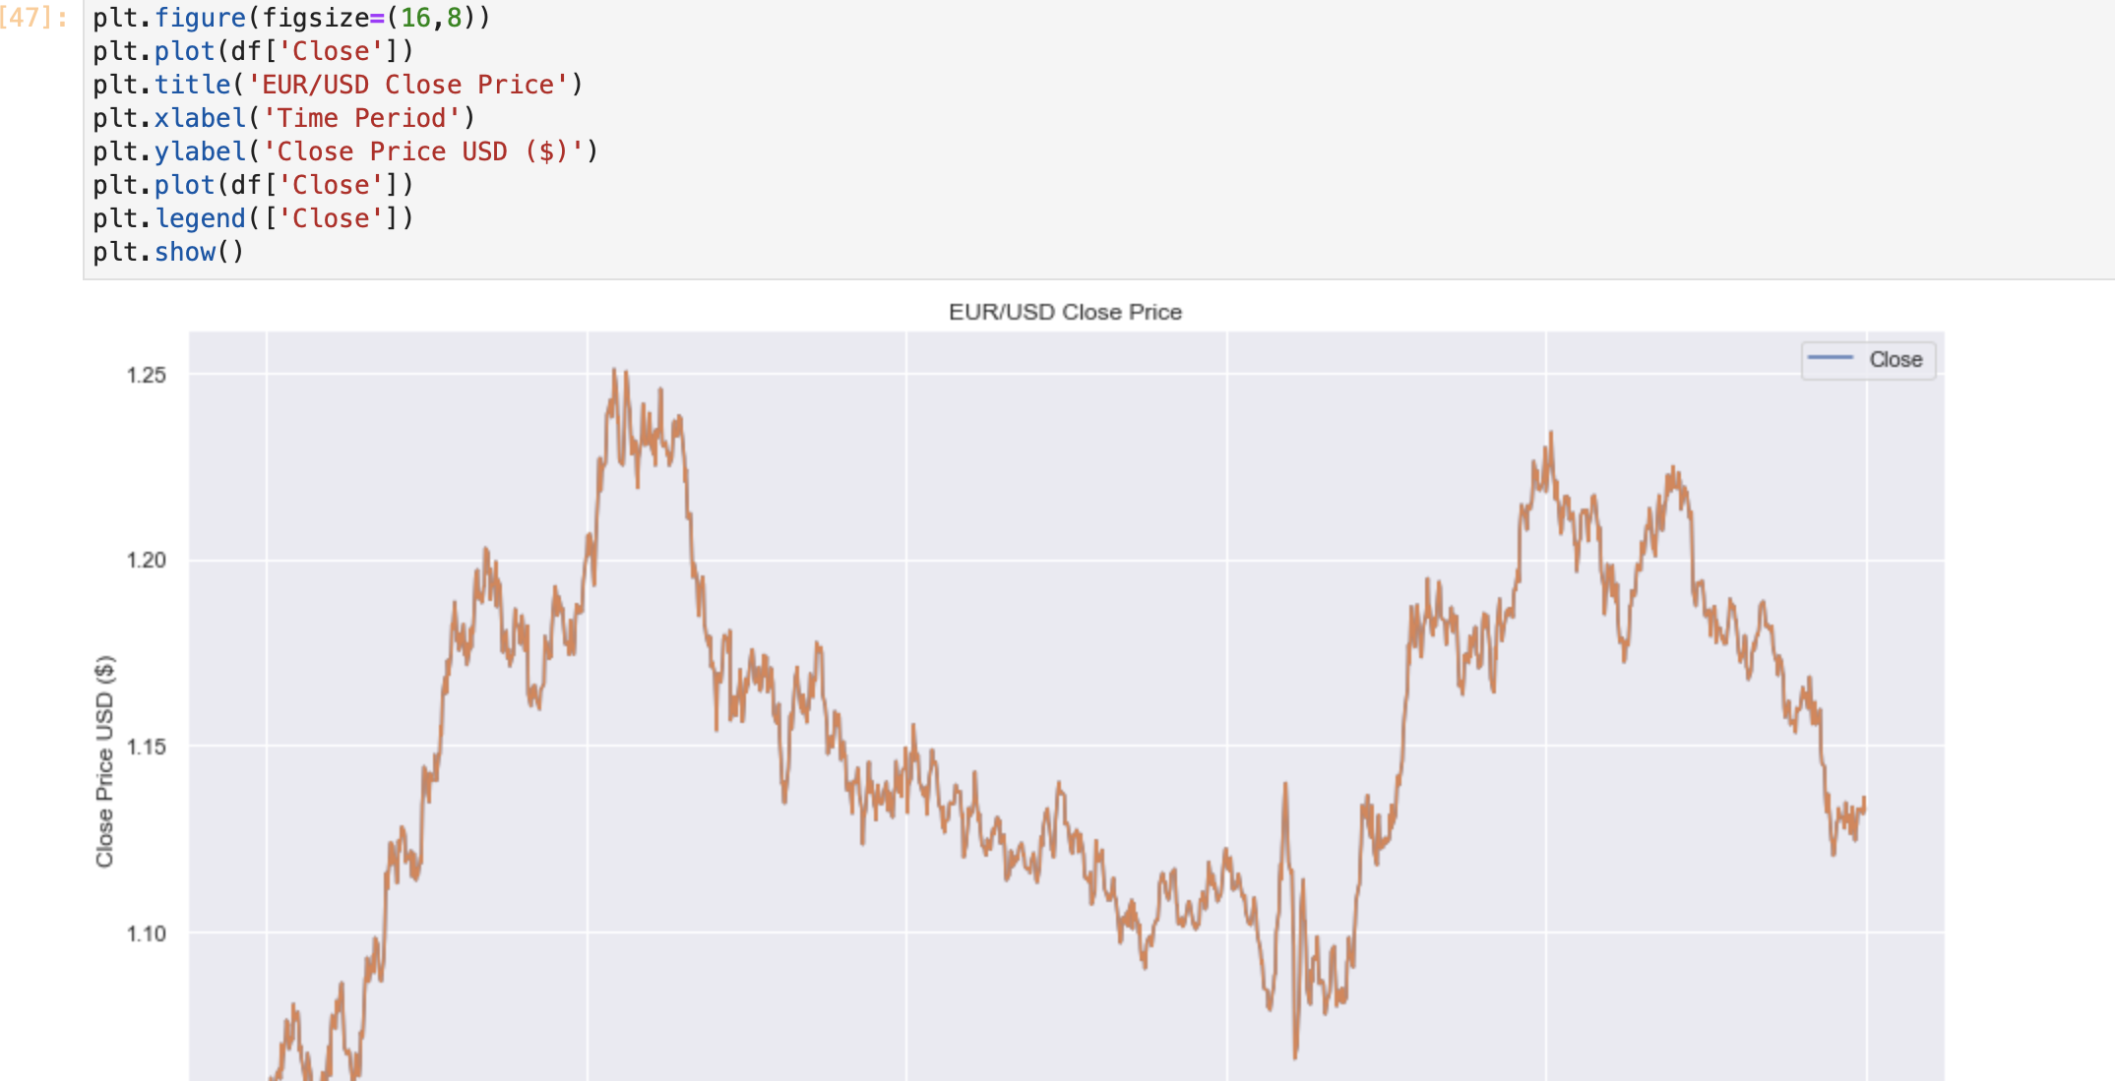

Slide 26
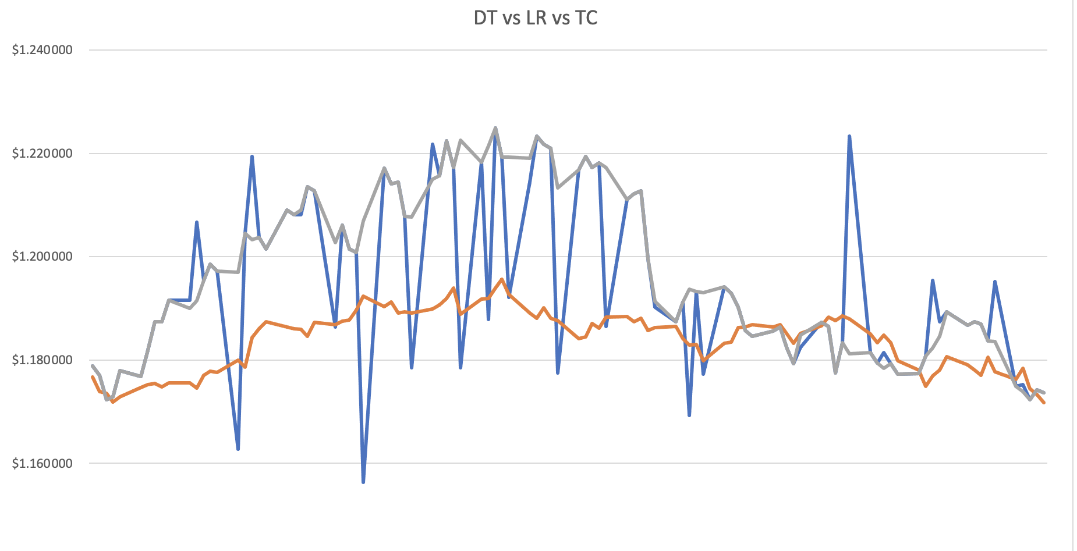

Slide 27
